Slide 1
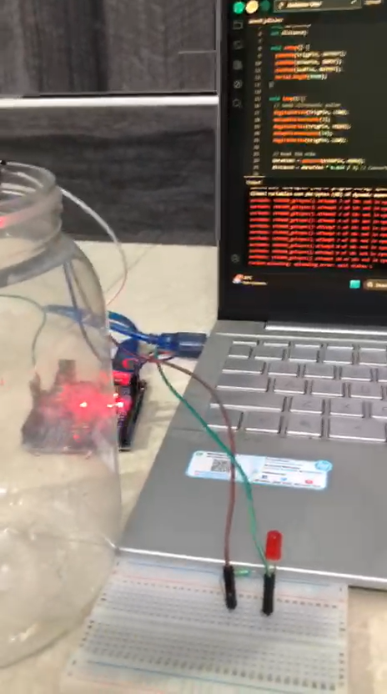
DIY Water Level Detector Using Arduino UNO and Ultrasonic Sensor in 10 min – Full Tutorial

Slide 2
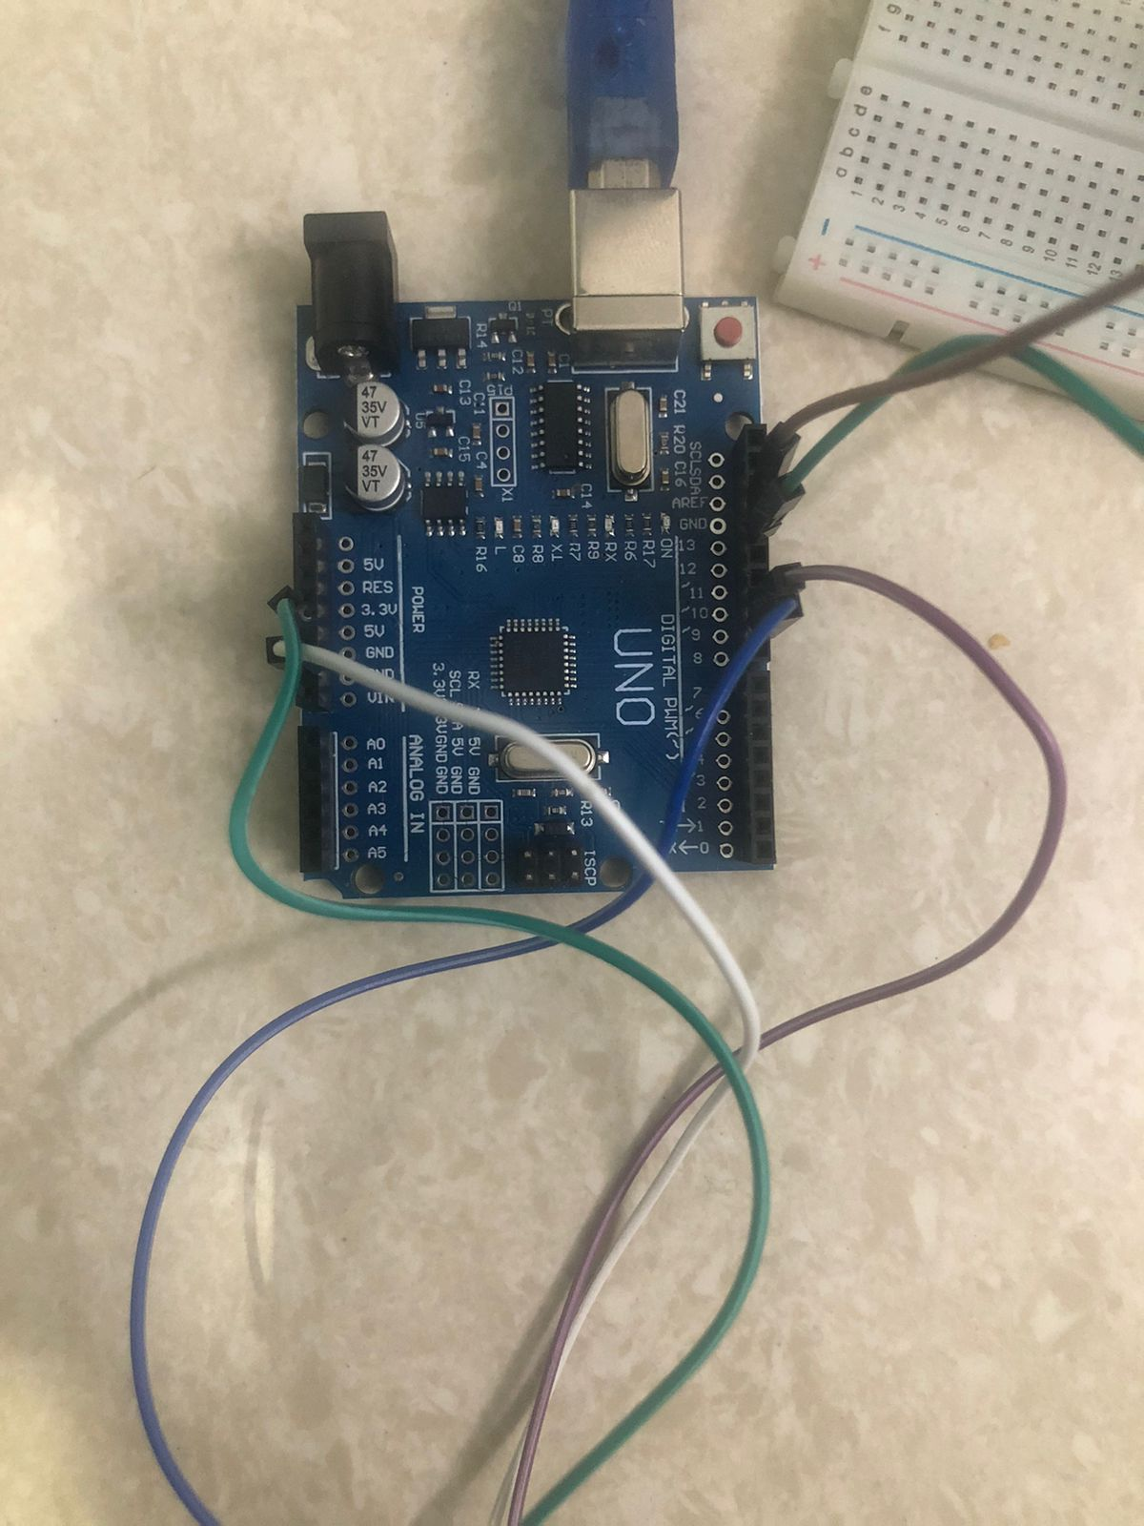
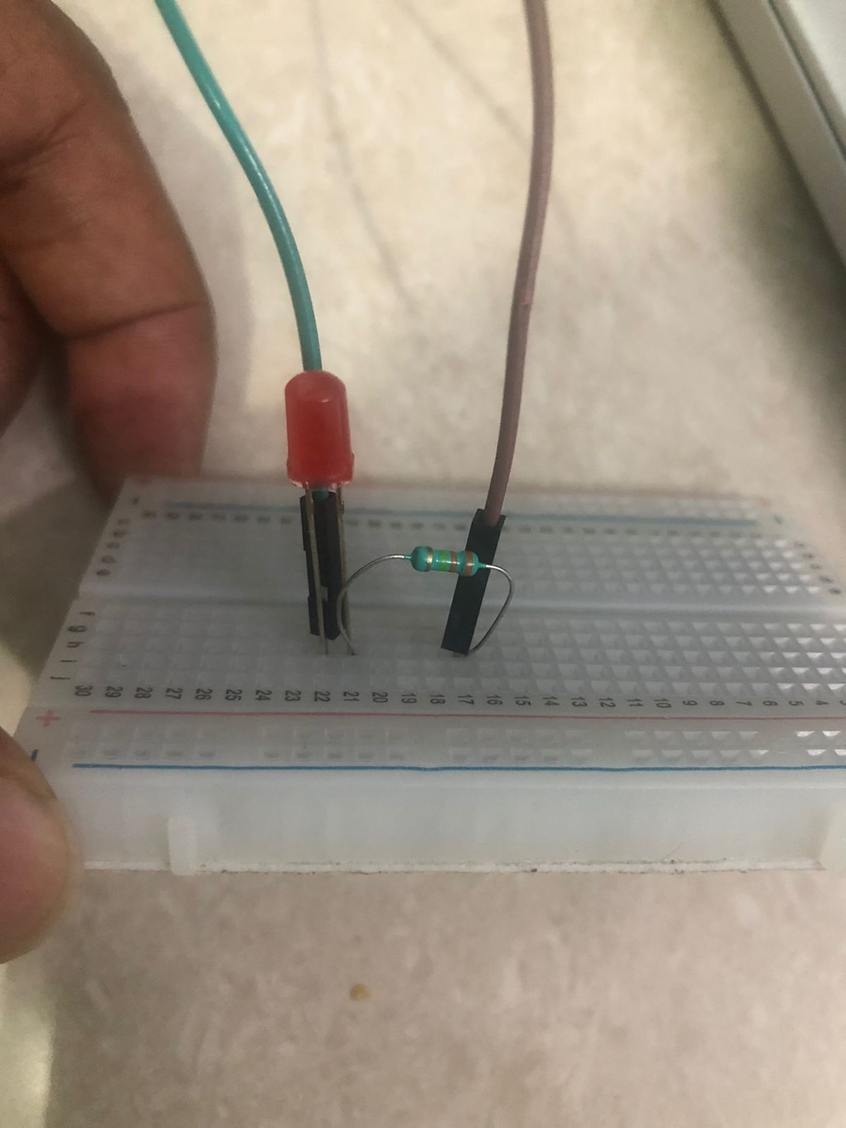
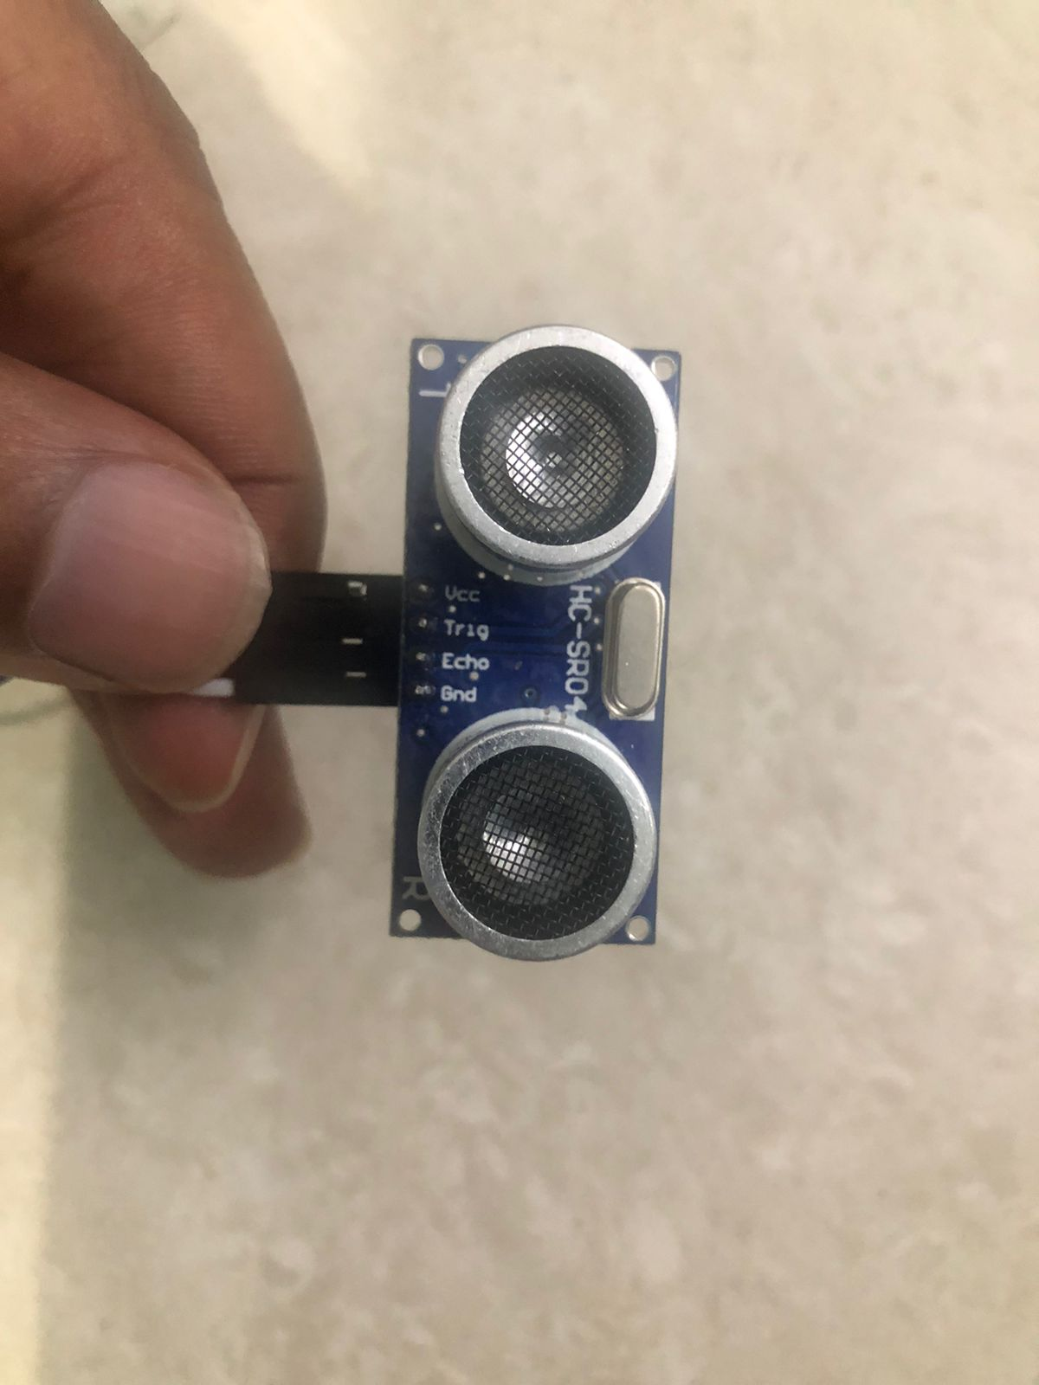
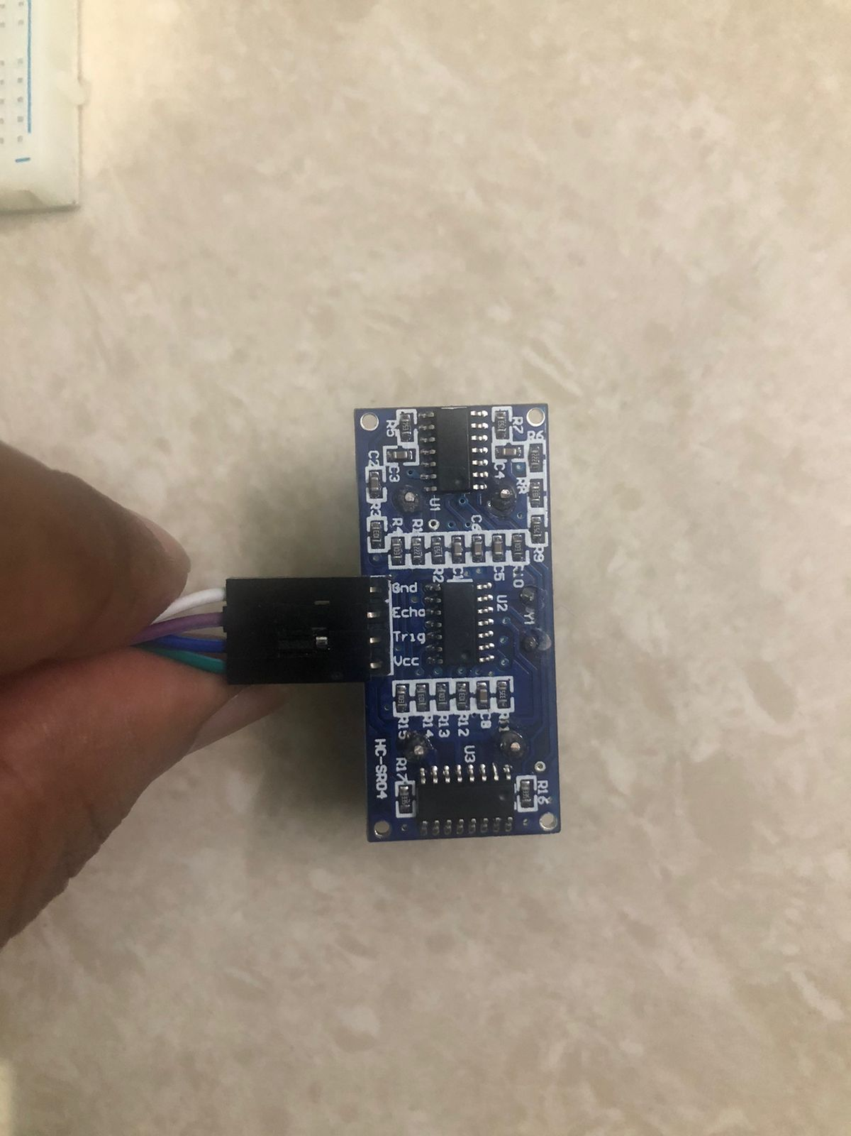
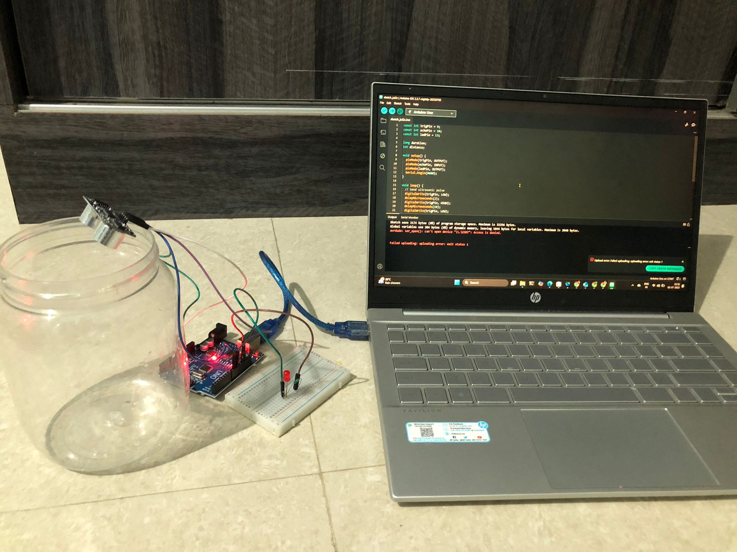

HC-SR04 Ultrasonic Sensor
Arduino UNO
LED + 220Ω resistor

Slide 3
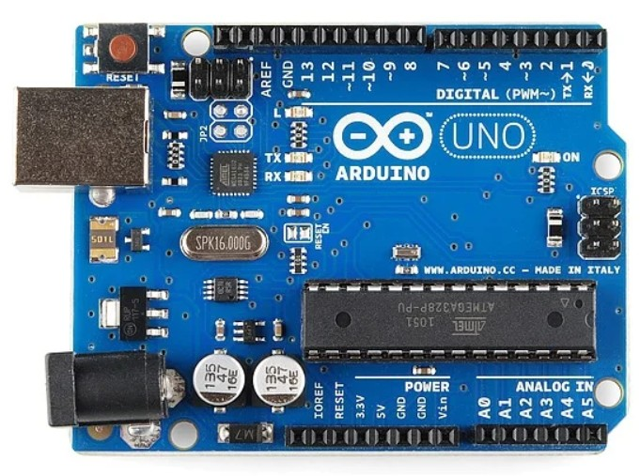
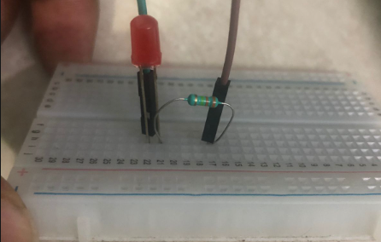


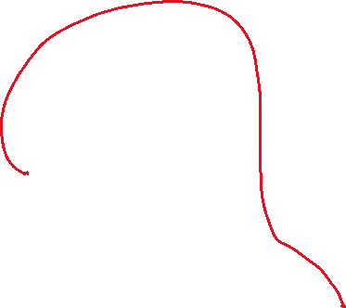




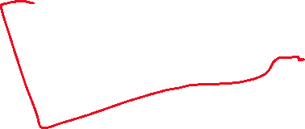
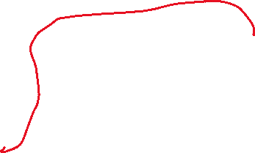
HC-SR04 VCC → 5V
HC-SR04 GND → GND
TRIG → Pin 9
ECHO → Pin 10
LED Cathode (short leg) → resistor → GND
LED Anode (long leg) → Pin 13
HC-SR04

Slide 4





Code Overview
const int trigPin = 9; #sends ultrasonic signal
const int echoPin = 10; #receives the echo
const int ledPin = 13; #controls LED (low water alert)
long duration; #time taken for sound to return
int distance; #distance in cm (calculated)
Two main functions:
setup() → runs once at start
loop() → repeats continuously
We use digital pins to control hardware
digitalWrite(trigPin, LOW);
delayMicroseconds(2);
digitalWrite(trigPin, HIGH);
delayMicroseconds(10);
digitalWrite(trigPin, LOW);
# Define input/output roles for pins
# Initialize serial communication for debugging
void setup() {
pinMode(trigPin, OUTPUT);
pinMode(echoPin, INPUT);
pinMode(ledPin, OUTPUT);
Serial.begin(9600);
}
# Start with LOW
# Send a 10μs HIGH pulse to trigger the sensor
# Sensor sends out ultrasonic sound
duration = pulseIn(echoPin, HIGH);
distance = duration * 0.034 / 2;
# pulseIn() waits for HIGH on ECHO pin
# Measures how long the sound took to return
# Output is in microseconds
# Speed of sound ≈ 0.034 cm/μs
# Divide by 2 (go and return)
# Now distance gives object/water surface distance in cm

Slide 5


Applications:
Overhead water tank monitoring
Plant watering automation
Home automation systems
Science projects
Scalability in Real-World Systems
Multi-tank management systems
Cloud-based dashboards with predictive analytics
Alert systems using SMS/email/IoT protocols (MQTT)

